Slide 1
Database Fundamentals
& SQL Server BI
IIHT-Capgemini Batch

Slide 2
What is database
Three levels to view:
▫ Level 1: literal meaning – the place where data is stored
Database = Data + Base, the actual storage of all the information that are interested
▫ Level 2: Database Management System (DBMS) The software tool package that helps gatekeeper and manage data storage, access and maintenances.
It can be either in personal usage scope (MS Access, SQLite) or enterprise level scope (Oracle, MySQL, MS SQL, etc).
▫ Level 3: Database Application All the possible applications built upon the data stored in databases (web site, BI application, ERP etc).

Slide 3
Database Examples
• Level 1: data collection text files in certain format: such as many bioinformatic databases
the actual data files of databases that stored through certain DBMS, i.e. MySQL, SQL server, Oracle, Postgresql, etc.
• Level 2: Database Management (DBMS) SQL Server, Oracle, MySQL, SQLite, MS Access, etc.
• Level 3: Database Application Web/Mobile/Desktop standalone application - e-commerce, online banking, online registration, etc.

Slide 4
Database Types
Flat Model
Navigational databases
Hierarchical (tree) database model
Network/Graph model
Relational Model
Object Model
Document Model
Entity-attribute-value model
Star schema

Slide 5
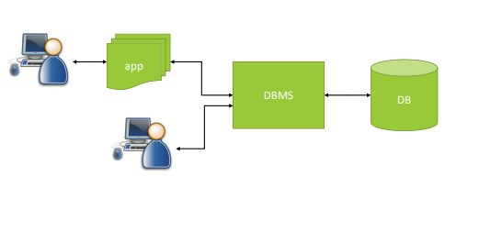
Database Application

Slide 6
Database Acronyms
SQL - Structured Query Language
CRUD - Create, Read, Update, Delete
ACID - Atomicity, Concurrency, Integrity and Durability

Slide 7
Disadvantages of Conventional flat files
Redundancy - same data may store in many different copies
▫ Inconsistency – data regarding to same business entity may appear in different forms, for example, state name, phone number, etc. This made it hard to modify data and keep clean track of change; even loss of data
▫ Mixture of all data together – not clear in logical relationships between the data columns, thus hard to understand and manage once the data structure gets complex
▫ Hard to maintain and manage
▫ No concurrency support (only one can operate on the file)

Slide 8
First Acronym - ACID
Atomicity – transactions are either all or none (commit/rollback)
Consistency – only valid data is saved
Isolation – transactions would not affect each other
Durability – written data will not be lost
Good example : bank transaction Most of challenges of ACID compliance come from multiple users/concurrent using of database

Slide 9
How Databases solve the problem?
Self-describing data collection of related records (meta data, data about data) , detail explanation as below: -
Self-describing means:
▫ Database not just contains data, but also contains definition of the structure of data, that can be considered ‘Meta data’;
It includes many related info : table column definition, index and key info, constraints, etc ▫ At database application level, database can also store other application related meta data as well, it makes personalization and customization of the application according to user profile much easier to handle.
The typical example could be the user preference for those common social media sites or e-commerce sites, etc.

Slide 10
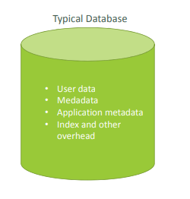
Database Content
User Data: tables to store user data
• Meta data: keep the structure (schema) of the data, including table name, column name and type and constraints over the column(s)
• Application metadata: application specific meta data regarding to user settings or functions of the application
• Index and other overhead data: used for improving performance and maintenance, such as logs, track, security, etc.

Slide 11
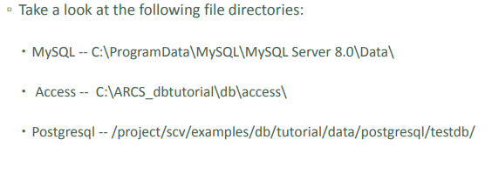
Data File Structure

Slide 12
Database Management System
A database management system (DBMS) is software that controls the storage, organization, and retrieval of data.
Typically, a DBMS has the following elements: • Kernel code This code manages memory and storage for the DBMS.
Repository of metadata
This repository is usually called a data dictionary.
Query language
This language enables applications to access the data
A database application is a software program that interacts with a database to access and manipulate data. The first generation of database management systems included the following types:
Hierarchical 1-1 : A hierarchical database organizes data in a tree structure. Each parent record has one or more child records, similar to the structure of a file system.
Network A network database is similar to a hierarchical database, except records have a many-to-many rather than a one-to-many relationship

Slide 13
Relational Model
In his seminar 1970 paper "A Relational Model of Data for Large Shared Data Banks," E. F. Codd defined a relational model based on mathematical set theory.
Today, the most widely accepted database model is the relational model.
A relational database is a database that conforms to the relational model. The relational model has the following major aspects: • Structures Well-defined objects store or access the data of a database.
• Operations Clearly defined actions enable applications to manipulate the data and structures of a database.
• Integrity rules Integrity rules govern operations on the data and structures of a database.
A relational database stores data in a set of simple relations. A relation is a set of tuples. A tuple is an unordered set of attribute values.
A table is a two-dimensional representation of a relation in the form of rows (tuples) and columns (attributes). Each row in a table has the same set of columns. A relational database is a database that stores data in relations (tables). For example, a relational database could store information about company employees in an employee table, a department table, and a salary table.

Slide 14
About RDBMS
RDBMS Stands for Relational Database Management System. RDBMS is the basis for SQL, and for all modern database systems like MSSQL Server, IBM DB2, MySQL and Microsoft Access.
A Relational database management system (RDBMS) is a database management system (DBMS) which is based on the relational model by E.F Codd.
The data in RDBMS is stored in database objects.
The relational model is the basis for a relational database management system (RDBMS).
An RDBMS moves data into a database, stores the data, and retrieves it so that applications can manipulate it. An RDBMS distinguishes between the following types of operations:
• Logical operations Chapter 1 About Relational Databases 1-2 In this case, an application specifies what content is required. For example, an application requests an employee name or adds an employee record to a table.
• Physical operations In this case, the RDBMS determines how things should be done and carries out the operation. For example, after an application queries a table, the database may use an index to find the requested rows, read the data into memory, and perform many other steps before returning a result to the user. The RDBMS stores and retrieves data so that physical operations are transparent to database applications.

Slide 15
Definition of Relational Database
One of the main benefits of computer databases is that they make it easy to store information so it's quick and easy to find. For example, an ecommerce system might use a database to record information about the products an organization sells, and the details of customers and the orders they've placed.
A relational database provides a model for storing the data, and a query capability that enables you to retrieve data quickly.
In a relational database, you model collections of entities from the real world as tables. An entity is described as a thing about which information needs to be known or held. In the ecommerce example, you might create tables for customers, products, and orders. A table contains rows, and each row represents a single instance of an entity

Slide 16
The Characteristics of RDBMS
All data is tabular. Entities are modeled as tables, each instance of an entity is a row in the table, and each property is defined as a column.
All rows in the same table have the same set of columns.
A table can contain any number of rows.
A primary key uniquely identifies each row in a table. No two rows can share the same primary key.
A foreign key references rows in another, related table. For each value in the foreign key column, there should be a row with the same value in the corresponding primary key column in the other table.
Examples of OLTP applications that use relational databases are:
Banking solutions
Online retail applications
Flight reservation systems
Many online purchasing applications.

Slide 17
The difference between DBMS & RDBMS
DBMS RDBMS
DBMS applications store data as file
DBMS does not support client/server architecture
DBMS does not allow normalization
DBMS does not impose integrity constraints.
 | RDBMS applications store data in a tabular form
 | RDBMS supports client/server architecture
 | RDBMS allows normalization
 | RDBMS imposes integrity constraints

Slide 18
Schema Objects
One characteristic of an RDBMS is the independence of physical data storage from logical data structures.
In Oracle Database, a database schema is a collection of logical data structures, or schema objects.
A database user owns a database schema, which has the same name as the user name.
Schema objects are user-created structures that directly refer to the data in the database. The database supports many types of schema objects, the most important of which are tables and indexes.
A schema object is one type of database object. Some database objects, such as profiles and roles, do not reside in schemas.

Slide 19
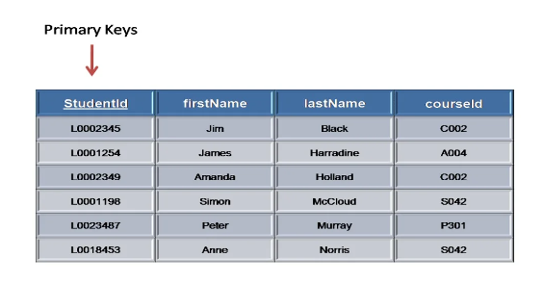
Creating Table

Slide 20
Creating Table
The data in RDBMS is stored in database objects called tables. The table is a collection of related data entries and it consists of columns and rows.
A table is the most common and simplest form of data storage in a relational database
A table describes an entity such as employees. You define a table with a table name, such as employees, and set of columns.
In general, you give each column a name, a data type, and a width when you create the table.
A table is a set of rows. A column identifies an attribute of the entity described by the table, whereas a row identifies an instance of the entity. For example, attributes of the employees entity correspond to columns for employee ID and last name.
A row identifies a specific employee. You can optionally specify a rule, called an integrity constraint, for a column. One example is a NOT NULL integrity constraint. This constraint forces the column to contain a value in every row.

Slide 21
Field, Record and Row
Every table is broken up into smaller entities called fields. This fields are in the Customers table consist of ID, NAME, AGE, ADDRESS and SALARY
A record, a row of data is each individual entry that exists in a table. There are 7 records in the Customers table.

Slide 22
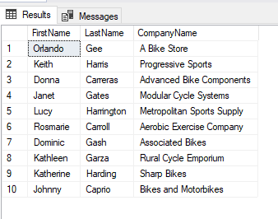
Column
A column or attribute is a vertical entity in a table which contains all information associated with a specific field in a table

Slide 23
Null Value
A NULL value in a table is a value in a field which appears to be blank which means a field with a NULL value is a field with no value.

Slide 24
Indexes
An index is an optional data structure that you can create on one or more columns of a table.
Indexes can increase the performance of data retrieval.
When processing a request, the database can use available indexes to locate the requested rows efficiently.
Indexes are useful when applications often query a specific row or range of rows.
Indexes are logically and physically independent of the data. Thus, you can drop and create indexes with no effect on the tables or other indexes. All applications continue to function after you drop an index.

Slide 25
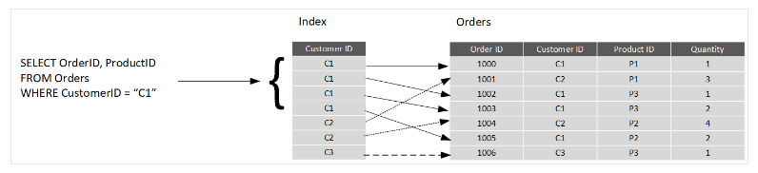
Example of Index
When you create an index in a database, you specify a column from the table, and the index contains a copy of this data in a sorted order, with pointers to the corresponding rows in the table.
When the user runs a query that specifies this column in the WHERE clause, the database management system can use this index to fetch the data more quickly than if it had to scan through the entire table row by row.
In this above example, the query retrieves all orders for customer C1. The Orders table has an index on the Customer ID column. The database management system can consult the index to quickly find all matching rows in the Orders table.

Slide 26
Terminology and Concepts - Tables (Relations)
The very central concepts of relational databases are Tables (Relations), Relationships.
Table (formally called ‘relation’) – is the building block of relational database. It stores data in 2D, with its row reflects one instance of record (tuple), and each of its column reflects one aspect of the attributes of all instances, column may also be called ‘field’.
For example, A ‘student’ table may contains (student id, first name, last name, grade, school name, home address, …), and each row may represent one student’s information, and each column of the table represents one piece of information of all students. And this is called a ‘relation’.

Slide 27
Primary Key and Foreign Key
Primary key: Unique Identifier made of one or more columns to uniquely identify rows in a table. If the primary key contains more than one column, it can be called ‘composite key’ as well.
Foreign Key: is the primary key of another table, which is referenced in the current table. It’s the key to establish the relationship between the two tables, and through DBMS, to impose referential integrity

Slide 28
Surrogate Key
Surrogate key is a unique column
• added to a relation to use as the primary key when lack of natural column serves as primary key, or when composite key needs to be replaced for various reasons.
• Surrogate key is usually in form of auto increment numeric value,
• Surrogate keys are often used in the place of composite key to add more flexibility to the table.

Slide 29
Integrity Constraints
Integrity constraints are a set of rules. It is used to maintain the quality of information.
Integrity constraints ensure that the data insertion, updating, and other processes have to be performed in such a way that data integrity is not affected.
Thus, integrity constraint is used to guard against accidental damage to the database.

Slide 30
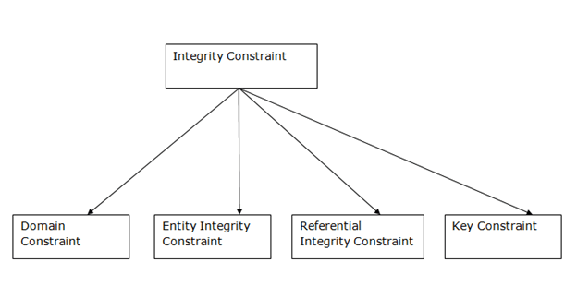
Types of Integrity Constraints

Slide 31
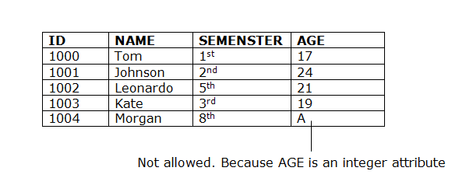
Domain Integrity Constraint
It’s defined as the definition of a valid set of values for an attribute.
The data type of domain includes string, character, integer, time, date, currency, etc. The value of the attribute must be available in the corresponding domain.
Example: In this Student’s table, the record “A” is not allowed in the AGE column

Slide 32
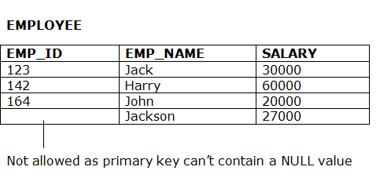
Entity Integrity Constraints
The entity integrity constraint states that primary key value can't be null.
This is because the primary key value is used to identify individual rows in relation and if the primary key has a null value, then we can't identify those rows.
A table can contain a null value other than the primary key field.
Example: In this EMPLOYEE table, the column “EMP_ID” is not allowed to have NULL value

Slide 33
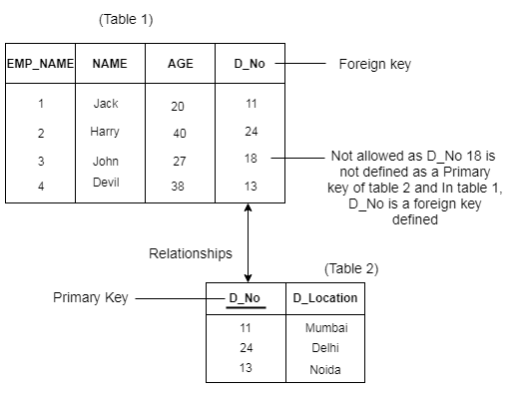
Referential Integrity Constraints
A referential integrity constraint is specified between two tables.
In the Referential integrity constraints, if a foreign key in Table 1 refers to the Primary Key of Table 2, then every value of the Foreign Key in Table 1 must be null or be available in Table 2.
Example: In these two tables, the column value of 18 from “D_No” attribute, is not allowed.

Slide 34
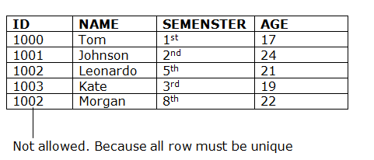
Key Constraints
Keys are the entity set that is used to identify an entity within its entity set uniquely.
An entity set can have multiple keys, but out of which one key will be the primary key. A primary key can contain a unique and null value in the relational table.
Example: In this Students table, column of ID value of 1002 is not allowed since all row must unique for ID column.

Slide 35
Terminology and Concepts (E.R Model)
E-R Model: Entity-Relationship data model is the common technique used in database design. It captures the relationships between database tables and represent them in a graphical way.
The relationships between two entities can be 1:1, 1:N, or M:N.
And it is usually established through ‘foreign key’ constraint.
Examples:
1:1 Employee – Locker
1:N Customer – Order,
Order – Order Detail
M:N Student – Course

Slide 36
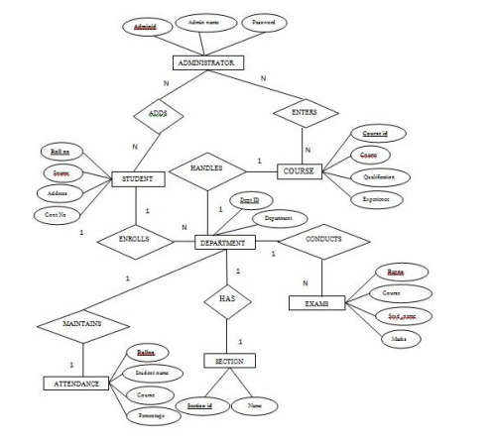
Sample ER Diagram
N:N relationship - administrator and student
N:N relationship - administrator and course
N:N relationship - Department and exams

Slide 37
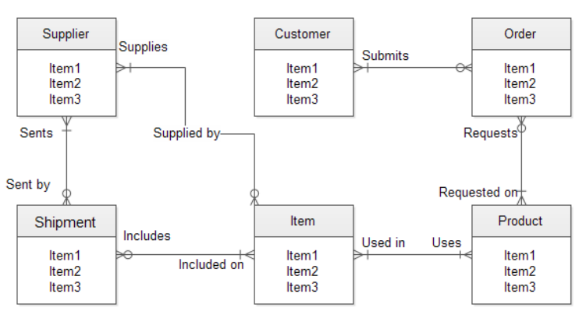
Sample ER Diagram

Slide 38
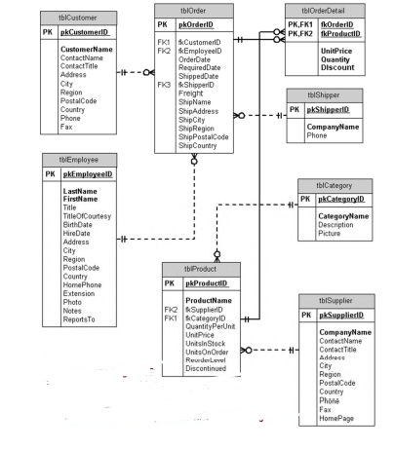
Sample ER Diagram
Relationships among multiple tables
Primary keys are indicated

Slide 39
Normalization
Database normalization, or simply normalization, is the process of restructuring a relational database in accordance with a series of so called normal forms in order to reduce data redundancy and improve data integrity. It was first proposed by Edgar F. Codd as an integral part of his relational model.
• Normalization entails organizing the columns (attributes) and tables (relations) of a database to ensure that their dependencies are properly enforced by database integrity constraints.
It is accomplished by applying some formal rules either by a process of synthesis (creating a new database design) or decomposition (improving an existing database design).

Slide 40
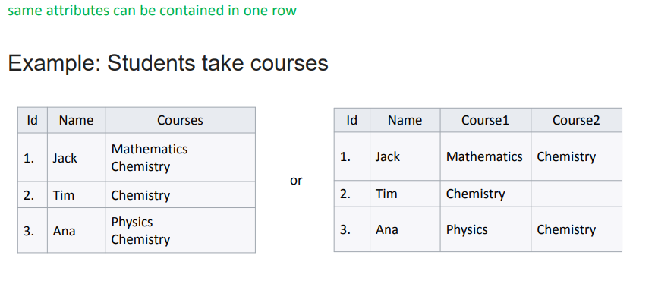
Unnormalized form (UNF)

Slide 41
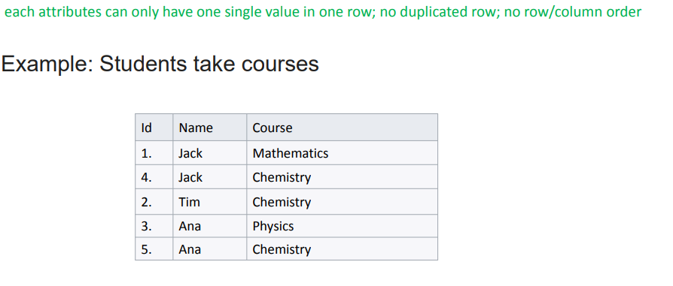
First Normal Form (1NF)

Slide 42
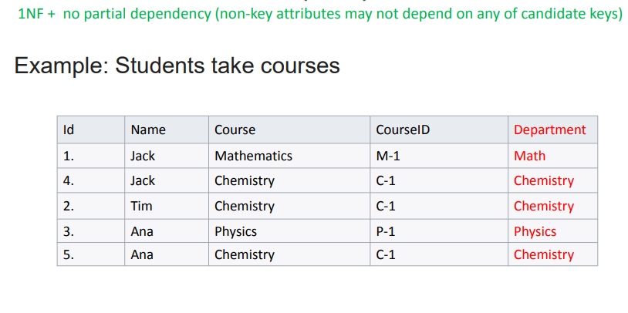
Second Normal Form (2NF)

Slide 43
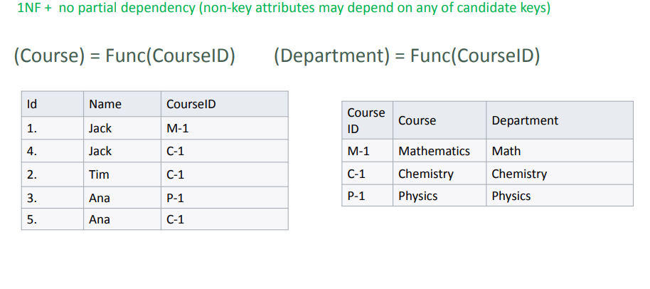
Second Normal Form (2NF) - continue..

Slide 44
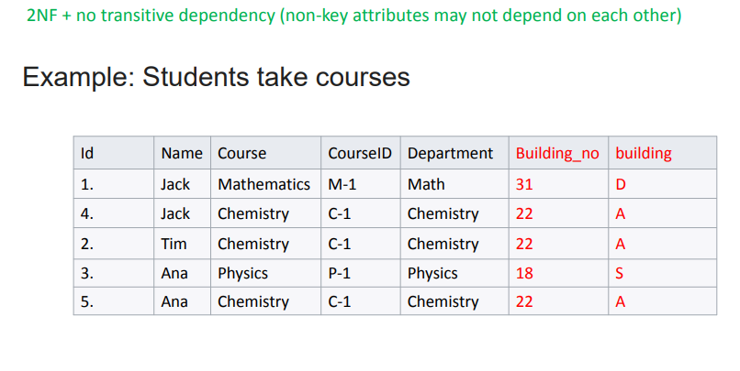
Third Normal Form (3NF)

Slide 45
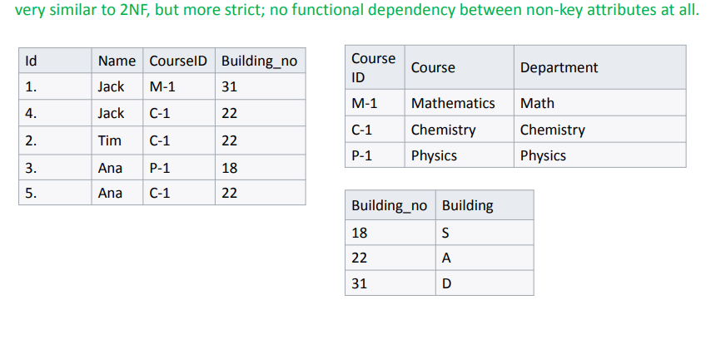
Third Normal Form (3NF) - continue..

Slide 46
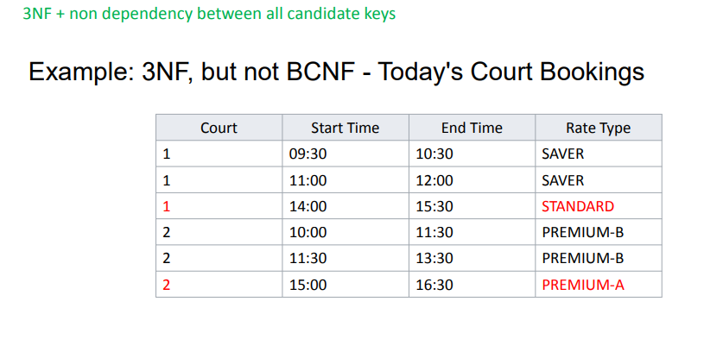
Boyce Codd Normal Form (BCNF)

Slide 47
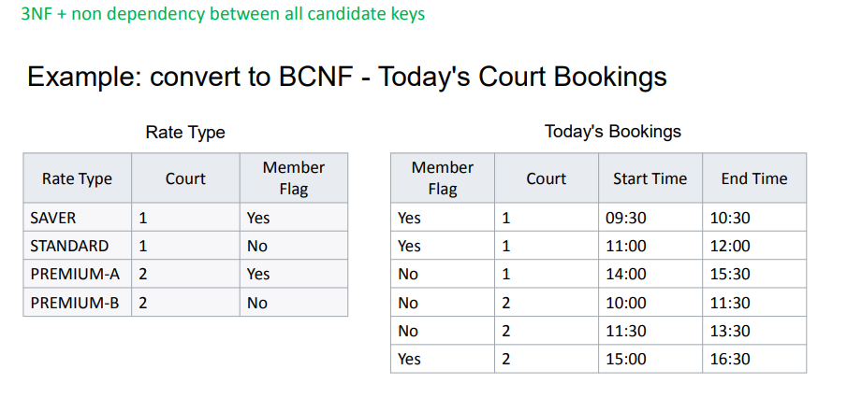
Boyce Codd Normal Form (BCNF)

Slide 48
Advantages of Normalization
BCNF+ normalization can eliminate all anomalies :
▫ No Redundancy
▫ No Inconsistency – all changes can only be made at the same place and keep consistent (because of the key constraints), in DB terminology – get away with all update anomaly.
▫ Normalization is the process of decomposition, so all the business concepts can be modeled with clear logical relationships
▫ The entire database system remains consistent over time as the database grows with least redundancy and much durability.
▫ Strong support to be ACID compliant

Slide 49
Advantages of Normalization
No(less) data redundancy – means easy management, less storage, etc.
• No headache caused by data operation anomalies. Good for data integrity and consistency.

Slide 50
Disadvantages of Normalization
Disadvantages of Normalization
• Take effort
• May increase complexity in data structure
• Data retrieving efficiency may be discounted due to the need of join of multiple tables; So may not be proper in read-intensive data applications
• Sometimes the constraints may be too strict to be flexible to make some customized change needed.

Slide 51
Disadvantages of Normalization
Hard to deal with complex data structures such as class, objects, rows in a field.
• Query for comprehensive information can be costly.
• Due to fixed predesigned structure, it is not flexible in terms of restructure of data

Slide 52
Denormalization
Normalization and denormalization both have advantages and disadvantages.
The best practice is always a trade off between the two.
• Denormalization will increase the risk of loss of data integrity and the size of storage, but may gain the simplicity and intuitivity of presenting data

Slide 53
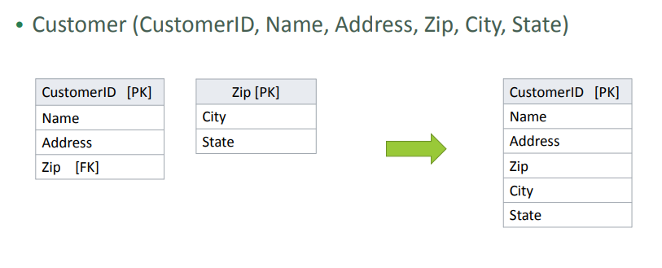
Denormalization - example

Slide 54
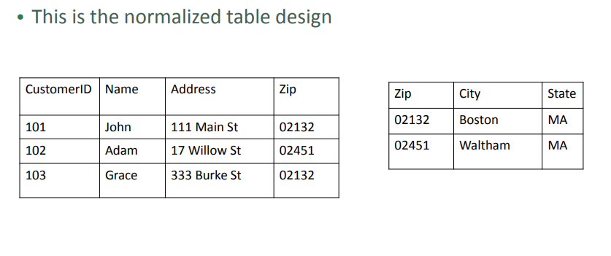
Denormalized table design - example

Slide 55
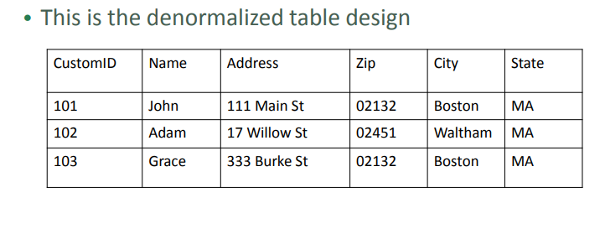
Denormalized table design - example

Slide 56
Database Operations
CRUD (Create/Read/Update/Delete) – four basic operations
• All through SQL (Structured Query Language)
▫ Sublanguage
▫ DDL (Data definition Language)
▫ DQL (Data Query Language)
▫ DML (Data Manipulation Language)
▫ DCL (Data Control Language)
▫ Scope of SQL: Query (select), Manipulate(Insert/update/delete), Definition(Create/Modify tables/columns) , Access Control (permission)

Slide 57
SQL
SQL is a standard language for accessing databases
SQL stands for Structured Query Language
SQL lets you access and manipulate databases
SQL is an ANSI (American National Standards Institute) standard

Slide 58
SQL Statements
A SQL statement can be thought of as a very simple, but powerful, computer program or instruction. Users specify the result that they want (for example, the names of employees), not how to derive it.
A SQL statement is a string of SQL text such as the following: SELECT first_name, last_name FROM employees;
SQL statements enable you to perform the following tasks: • Query data • Insert, update, and delete rows in a table
• Create, replace, alter, and drop objects
• Control access to the database and its objects
• Guarantee database consistency and integrity SQL unifies the preceding tasks in one consistent language.

Slide 59
Benefits of SQL
SQL can execute queries against a database
SQL can retrieve data from a database
SQL can insert records in a database
SQL can update records in a database
SQL can delete records from a database

Slide 60
Using SQL in your project
To build an application which shows data from a database, we’ll require.
An RDBMS database program (MS Access, SQL Server & MySQL)
To use a server-side scripting language like PHP, Java
To use SQL to get the data looking for
To use HTML / CSS

Slide 61
SQL Data Types
INTEGER - The INTEGER data type is used to specify an integer value
SMALLINT - The SMALLINT data type is used to specify small integer value
NUMERIC (P,S) - It specifies a numeric value. Here p is precision value and ‘s’ is scale value.

Slide 62
SQL Data Types
Float Types
Float (P) - It specifies floating-point value. The ‘p’ is precision value.
Double Precision - It specifies the double precision floating point number
REAL - The real integer is used to specify the single precision floating point number.
Decimal (P,S) - It specifies a decimal value. Here P is precision value and ‘s’ is scale value.

Slide 63
SQL Data Type
String Types
CHAR(X) - Here ‘x’ is the characteristic number to store. Here char should be used for storing fix length strings.
VARCHAR2(X) - Here ‘x’ is character’s number to store. Varchar is used to store variable length strings. The String value’s length will be stored in dish with the value itself.

Slide 64
SQL Data Type
DATE & TIME Type
Date -It stores year, month and days value
Time - It stores hour, minute and second values.
Timestamp - The timestamp data type is used to year, month, day, hour, minute and second values.

Slide 65
Important SQL Commands (DDL)
SELECT - extracts data from a database
UPDATE - updates data in a database
DELETE - deletes data from a database
INSERT INTO - inserts new data into a database
CREATE DATABASE - creates a new database

Slide 66
SQL Command (DML)
ALTER DATABASE - Modifies a database
CREATE TABLE - Creates a new table
ALTER TABLE - modifies a table
DROP TABLE - deletes a table
TRUNCATE TABLE - deletes the data inside the table. But not the table itself
RENAME TABLE (TSQL) - This example renames the SQL table from “SalesTerritory” to “SalesTerr” in Sales schema.
USE AdventureWorks2012;
GO
EXEC sp_rename 'Sales.SalesTerritory', 'SalesTerr';

Slide 67
SQL Command (DCL)
Grant Command
SQL Grant is used to provide permissions like Select, All, Execute to user on the database objects like Tables, Views, Databases and other objects in a SQL Server.
Syntax
Grant privilageName
on objectName
To{userName/Public/roleName}
[with Grant Option]

Slide 68
SQL Command (DCL)
Revoke Command
SQL Revoke is used to remove the permissions or privileges of a user on database objects set by the Grant command.
Syntax
Revoke privilageName
on objectName
from{userName/public/roleName}

Slide 69
SQL Command (TCL)
A transaction is a single unit of work. If a transaction is successful, all of the data modifications made during the transaction are committed and become a permanent part of the database. If a transaction encounters errors and must be canceled or rolled back, then all of the data modifications are erased.
SQL Server operates in the following transaction modes:
Autocommit transactions
Each individual statement is a transaction.
Explicit transactions
Each transaction is explicitly started with the BEGIN TRANSACTION statement and explicitly ended with a COMMIT or ROLLBACK statement.

Slide 70
SQL Transactions
Implicit transactions
A new transaction is implicitly started when the prior transaction completes, but each transaction is explicitly completed with a COMMIT or ROLLBACK statement.
Batch-scoped transactions
Applicable only to multiple active result sets (MARS), a Transact-SQL explicit or implicit transaction that starts under a MARS session becomes a batch-scoped transaction. A batch-scoped transaction that is not committed or rolled back when a batch completes is automatically rolled back by SQL Server.

Slide 71
BEGIN TRANSACTION
Marks the starting point of an explicit, local transaction. Explicit transactions start with the BEGIN TRANSACTION statement and end with the COMMIT or ROLLBACK statement.
BEGIN TRANSACTION increments @@TRANCOUNT by 1.
BEGIN TRANSACTION represents a point at which the data referenced by a connection is logically and physically consistent. If errors are encountered, all data modifications made after the BEGIN TRANSACTION can be rolled back to return the data to this known state of consistency.
Each transaction lasts until either it completes without errors and COMMIT TRANSACTION is issued to make the modifications a permanent part of the database, or errors are encountered and all modifications are erased with a ROLLBACK TRANSACTION statement.

Slide 72
COMMIT TRANSACTION
BEGIN TRANSACTION starts a local transaction for the connection issuing the statement.
Depending on the current transaction isolation level settings, many resources acquired to support the Transact-SQL statements issued by the connection are locked by the transaction until it is completed with either a COMMIT TRANSACTION or ROLLBACK TRANSACTION statement.
Transactions left outstanding for long periods of time can prevent other users from accessing these locked resources, and also can prevent log truncation.
Example of COMMIT Transaction
BEGIN TRANSACTION;
DELETE FROM HumanResources.JobCandidate
WHERE JobCandidateID = 13;
COMMIT;

Slide 73
ROLLBACK TRANSACTION
CREATE TABLE Value Table (id INT);
BEGIN TRANSACTION;
INSERT INTO ValueTable VALUES(1);
INSERT INTO ValueTable VALUES(2);
ROLLBACK;
This example shows the effect of rolling back a transaction.
In this example, the ROLLBACK statement will roll back the INSERT statement, but the created table will still exist.

Slide 74
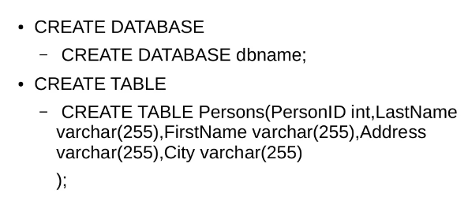
SQL Syntax

Slide 75
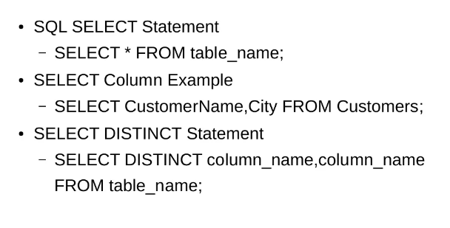
SQL Syntax

Slide 76
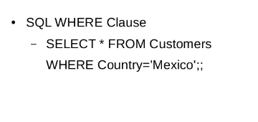
SQL Syntax

Slide 77
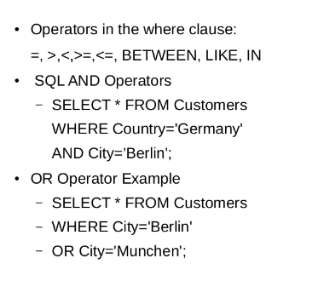
SQL Syntax

Slide 78
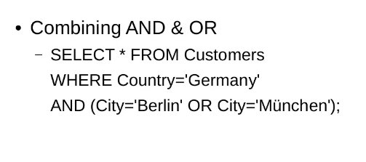
SQL Syntax

Slide 79
ORDER BY Keyword
The ORDER BY keyword is used to sort the result-set by one or more columns
The ORDER BY keyword sorts the records in ascending order by default. To sort the records in a descending order, you can use the DESC keyword.

Slide 80
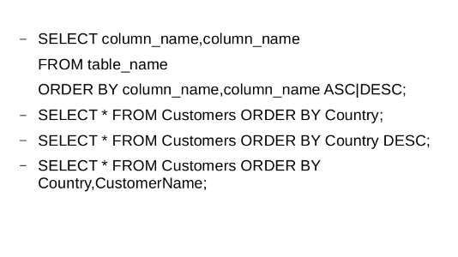
ORDER BY Keyword

Slide 81
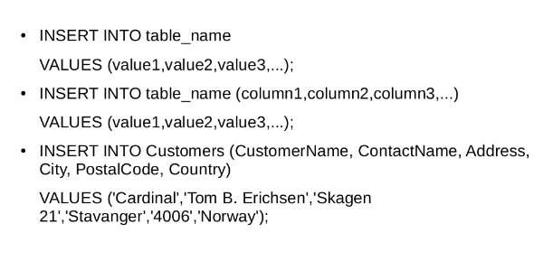
INSERT INTO STATEMENT

Slide 82
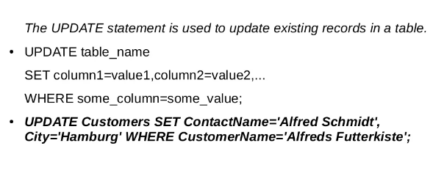
UPDATE Statement

Slide 83
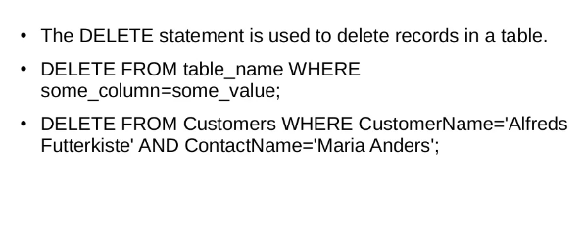
DELETE Statement

Slide 84
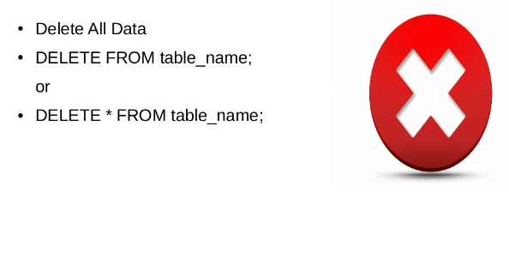
DELETE Statement

Slide 85
SELECT TOP
SELECT TOP clause is used to specify the number of records to return
SELECT TOP clause can be very useful on large tables with thousands of records. Returning a large number of records can impact on performance.

Slide 86
SELECT TOP Command
SELECT TOP (expression) [PERCENT]
[WITH TIES]
FROM
table_name
ORDER BY
column_name;
In this syntax, the SELECT statement can have other clauses such as WHERE, JOIN, HAVING, and GROUP BY.
expression
Following the TOP keyword is an expression that specifies the number of rows to be returned. The expression is evaluated to a float value if PERCENT is used, otherwise, it is converted to a BIGINT value.
PERCENT
The PERCENT keyword indicates that the query returns the first N percentage of rows, where N is the result of the expression.

Slide 87
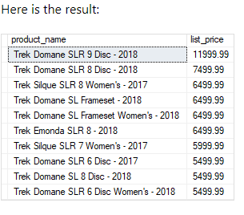
SQL Server TOP examples
Using TOP with a Constant value
(Use a constant value to return the top 10 most expensive products)
SELECT TOP 10
product_name,
list_price
FROM
production.products
ORDER BY
list_price DESC;

Slide 88
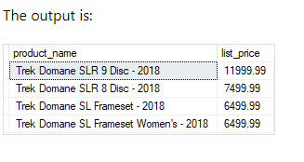
SQL Server Top examples
It uses PERCENT to specify the number of products returned in the result set. The production.products table has 321 rows, therefore, one percent of 321 is a fraction value ( 3.21), SQL Server rounds it up to the next whole number which is four ( 4) in this case.
SELECT TOP 1 PERCENT
product_name,
list_price
FROM
production.products
ORDER BY
list_price DESC;

Slide 89
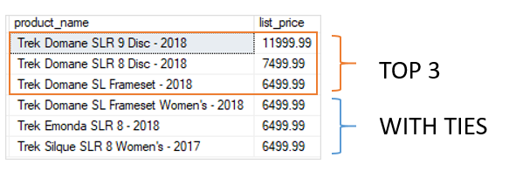
SQL Top Command to return a % of rows
example uses PERCENT to specify the number of products returned in the result set. The production.products table has 321 rows, therefore, one percent of 321 is a fraction value ( 3.21), SQL Server rounds it up to the next whole number which is four ( 4) in this case.
SELECT TOP 3 WITH TIES
product_name,
list_price
FROM
production.products
ORDER BY
list_price DESC;

Slide 90
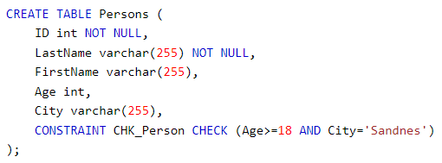
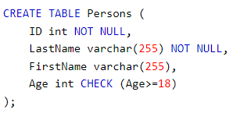
Adding a Check Constraint
The CHECK constraint is used to limit the value range that can be placed in a column.
If you define a CHECK constraint on a column it will allow only certain values for this column.
If you define a CHECK constraint on a table it can limit the values in certain columns based on values
in other columns in the row.
Example of CHECK Constraint

Slide 91
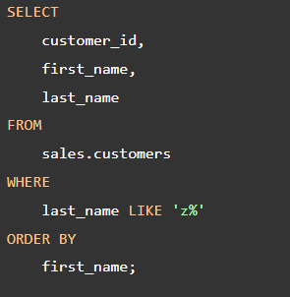
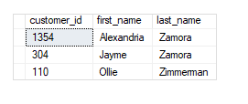
LIKE Operator in TSQL
The SQL Server LIKE is a logical operator that determines if a character string matches a specified pattern.
A pattern may include regular characters and wildcard characters.
The LIKE operator is used in the WHERE clause of the SELECT, UPDATE, and DELETE statements to filter rows based on
pattern matching.
Syntax:
Column | expression LIKE pattern [ESCAPE escape_character]

Slide 92
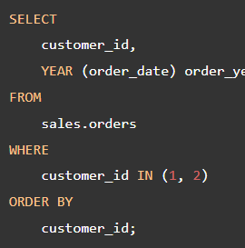
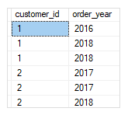
Group By Clause
The GROUP BY clause allows you to arrange the rows of a query in groups.
The groups are determined by the columns that you specify in the GROUP BY clause.
SELECT
select_list
FROM
table_name
GROUP BY
column_name1,
column_name2, ;
In this query, GROUP BY clause produced a group for each combination of values in the columns listed in the GROUP BY clause.

Slide 93
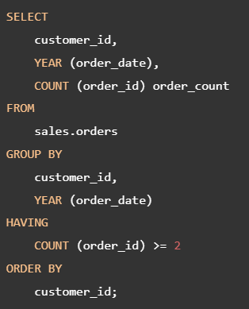
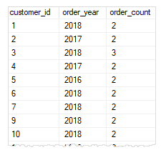
HAVING clause
The HAVING clause is often used with the GROUP BY clause to filter groups based on a specified list of conditions.
The following illustrates the HAVING clause syntax:
Syntax: the GROUP BY clause summarizes the rows into groups and the HAVING clause applies one or more conditions to these groups.
SELECT
select_list
FROM
table_name
GROUP BY
group_list
HAVING
conditions;

Slide 94
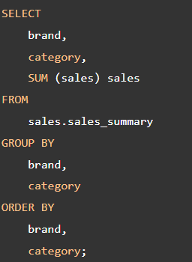
GROUPING SETS in SQL
A grouping set is a group of columns by which you group. Typically, a single query with an aggregate defines a single grouping set.
The following query defines a grouping set includes brand & category which is denoted as (brand, category.
The query returns the sales amount grouped by brand & category.

Slide 95
OFFSET & FETCH Clause in tSQL
The OFFSET and FETCH clauses are the options of the ORDER BY clause.
They allow you to limit the number of rows to be returned by a query.
SELECT
product_name,
list_price
FROM
production.products
ORDER BY
list_price,
product_name
OFFSET 10 ROWS
FETCH NEXT 10 ROWS ONLY;

